Slide 1

Beers & Breweries
DDS Fall Case Study 1 - Michael Schulte

Slide 2
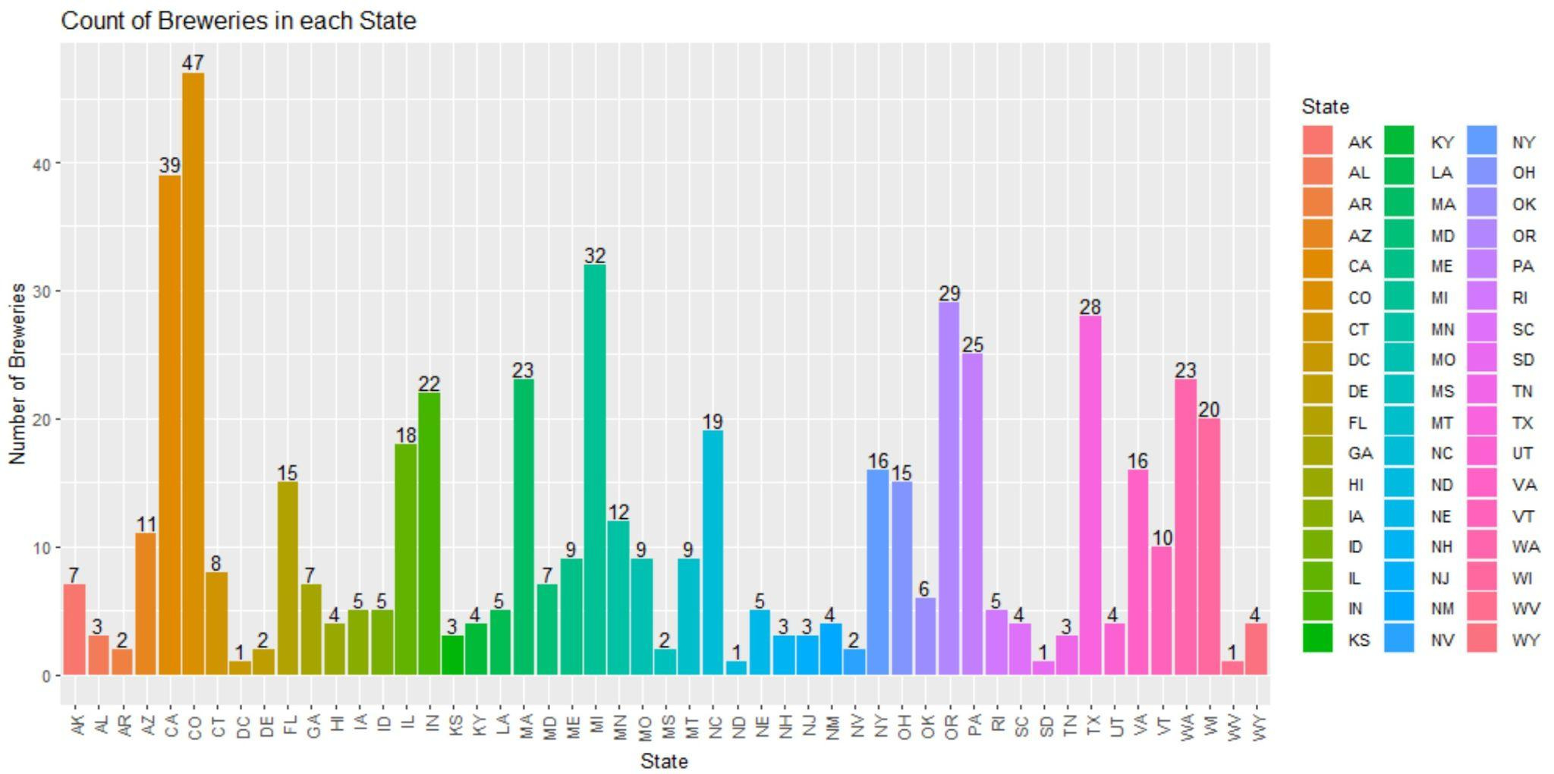
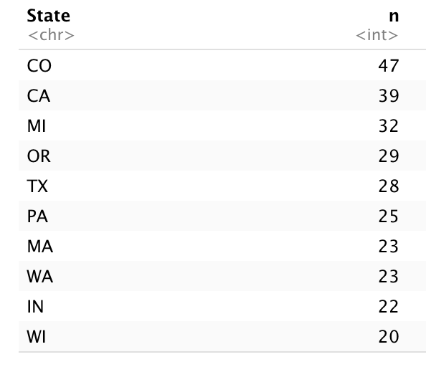
Count of Breweries in each State
Top 10 States with most Breweries
Top states: Colorado, California, Michigan, Oregon, Texas, Pennsylvania, Massachusetts, Washington, Indiana, Wisconsin

Slide 3
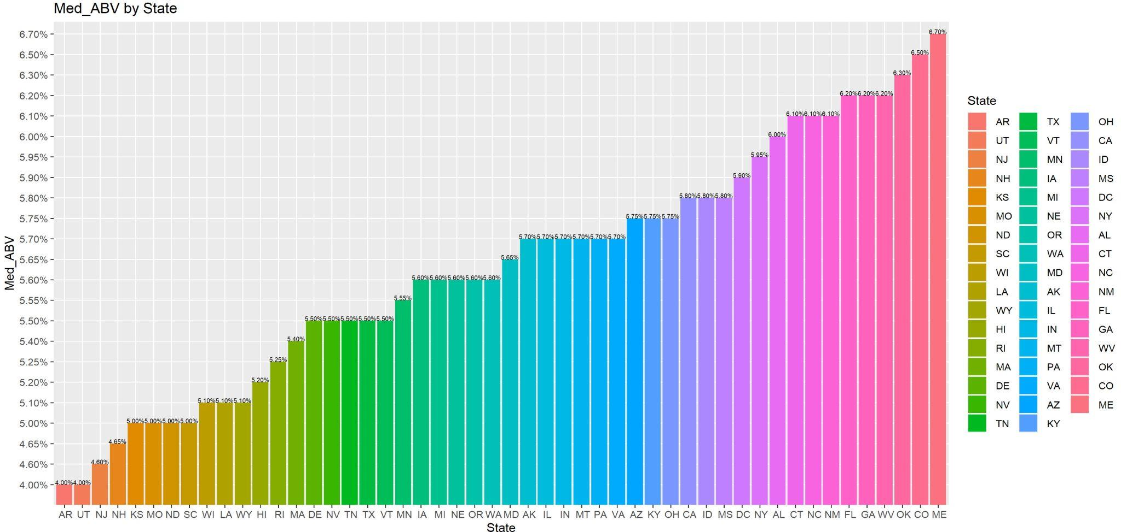
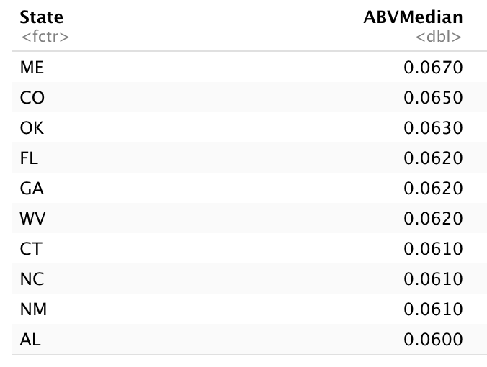
Median ABV by State
Top 10 States with highest Median ABV
Top 10 Highest Median ABV by State: Maine, Colorado, Oklahoma, Florida, Georgia, West Virginia, New Mexico, North Carolina, Connecticut, Alabama

Slide 4
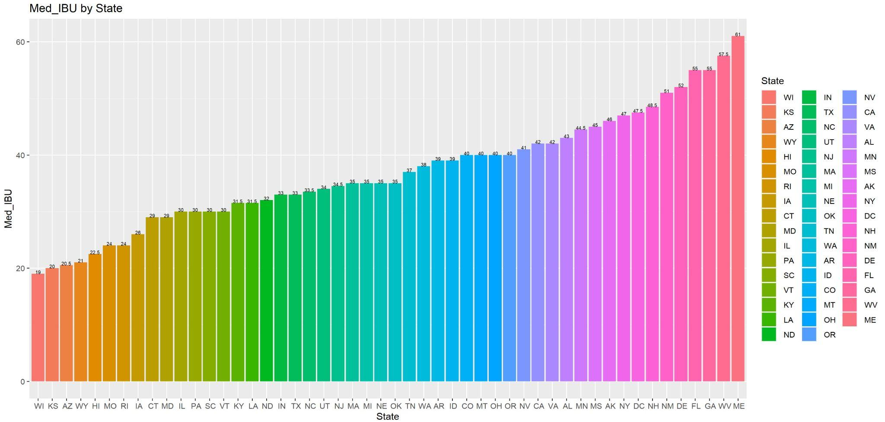
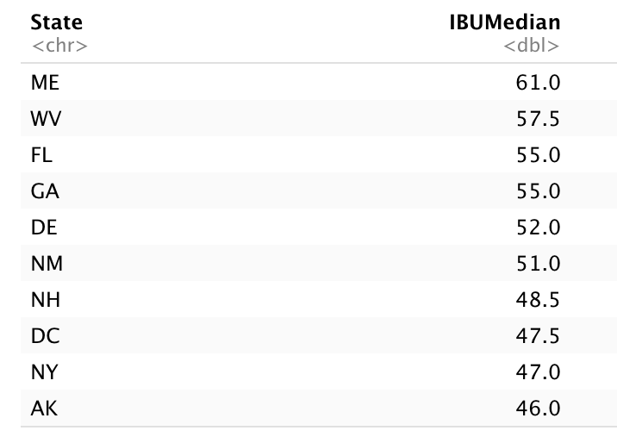
Median IBU by State
Top 10 States with highest Median IBU
Top 10 Highest Median ABV by State: Maine, West Virginia, Florida, Georgia, Delaware, New Mexico, New Hampshire, Washington D.C., New York, Arkansas

Slide 5
Max ABV & IBU
Max ABV State: CO - “Upslope Brewing Company”
Max IBU State: OR - “Astoria Brewing Company”

Slide 6
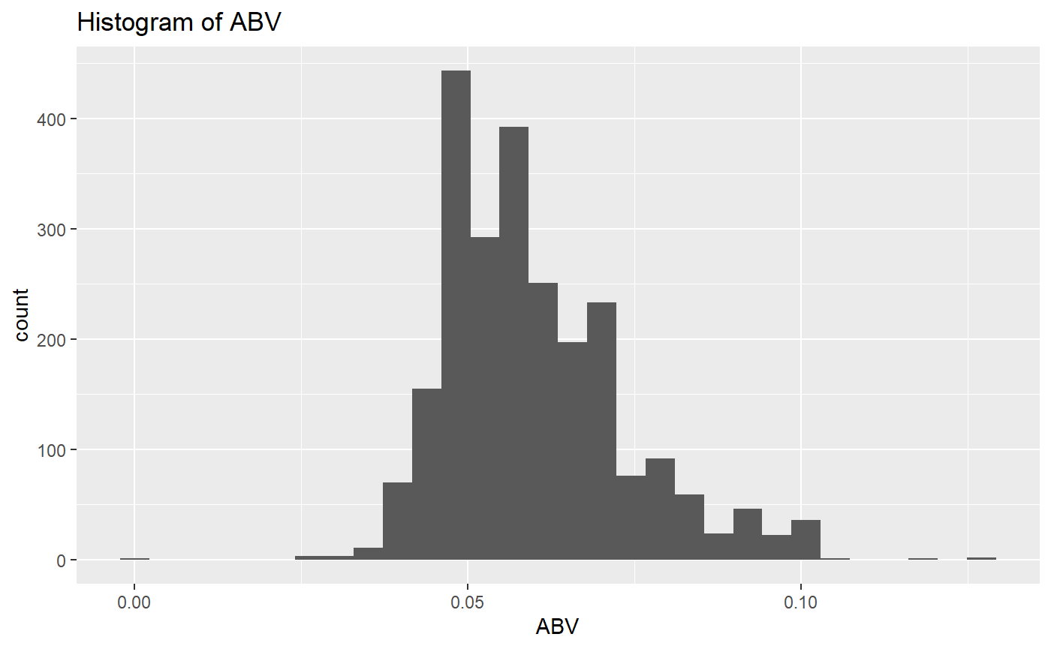
ABV - Statistics & Distribution
Summary Statistics:
Min = .001 or .1%
Max= .128 or 12.8%
1st Quartile= .05 or 5%
Median= .0565 or 5.65%
3rd Quartile= .067 or 6.7%
Distribution of the ABV is slightly skewed to the right.

Slide 7
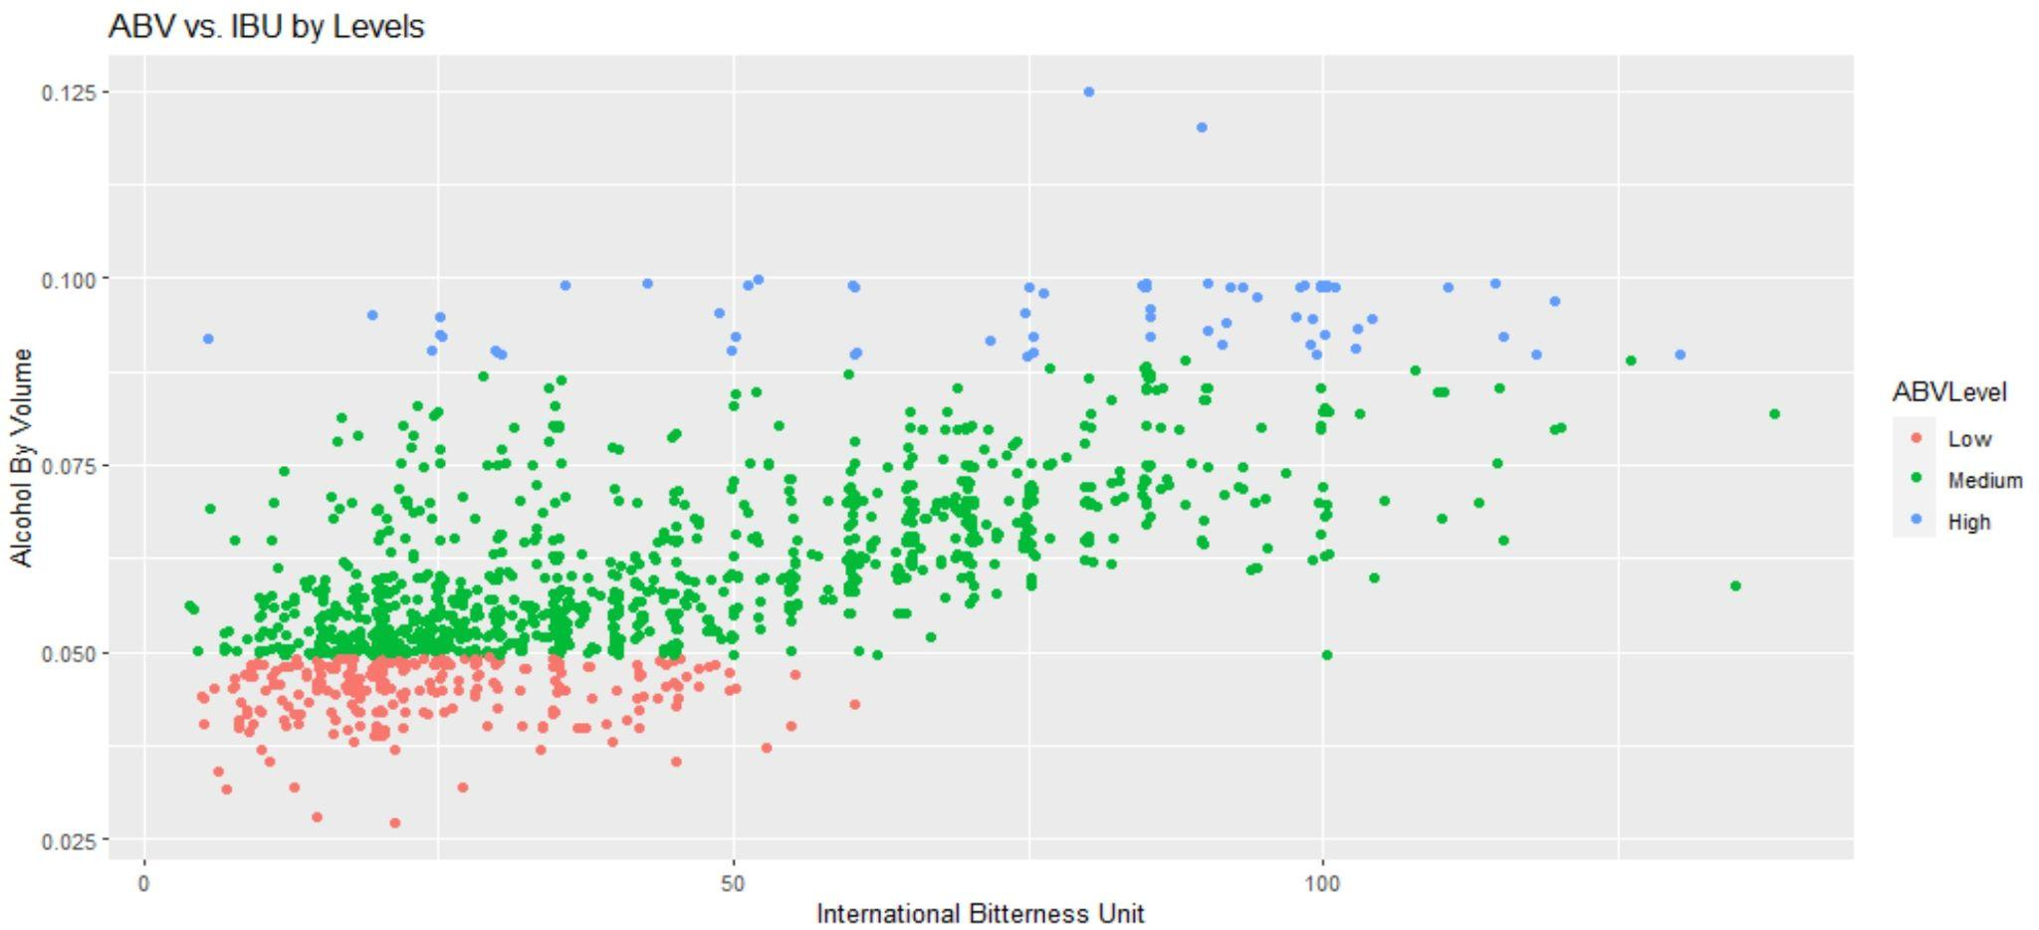
Alcohol Content vs. Bitterness
Legend Measure - - Low(.00 to .049), Medium(.05 to .089), High(.09 to .13), No N/A values included

Slide 8
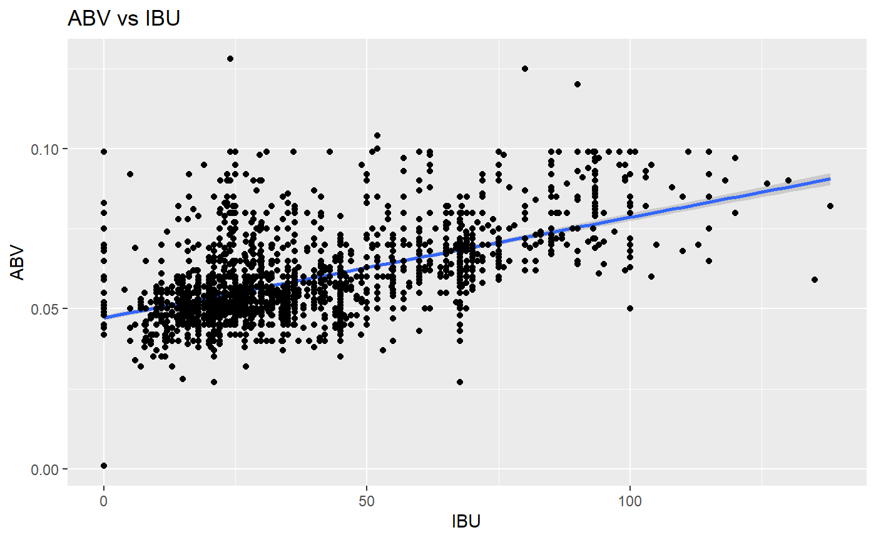
Alcoholic Content vs. Bitterness

Slide 9
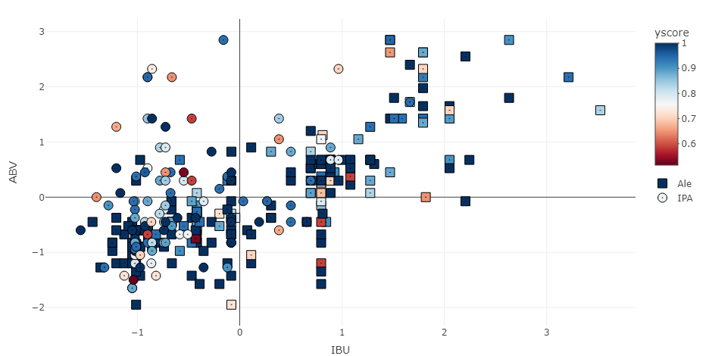
KNN Plot

Slide 10
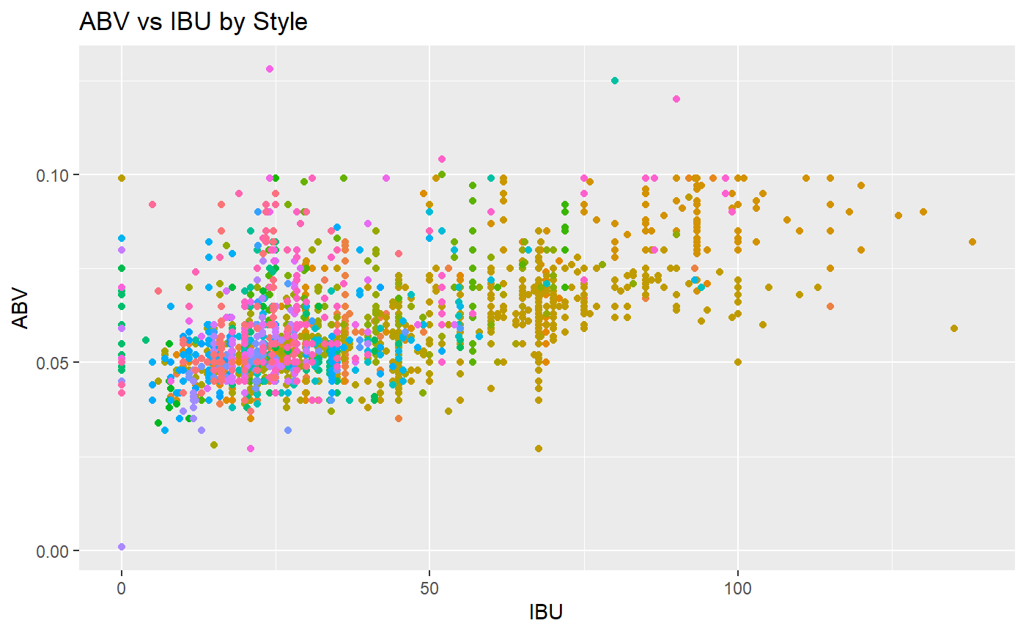
Bitterness and Alcoholic Content By Beer Style
There is significant evidence to prove that at least one Style has a different IBU, and one style has a different ABV (p-value < 2e-16).

Slide 11
Summary
Looked at top ten states to mark for further analysis.
The median shows that the highest median comes from ME. The breweries in areas brew to their customers. Certain states prefer different types of beer.
The data is vague and lacks metrics like popularity. What directions to take this data?
Build a more indepth model for classification that focuses on more styles and more parameters (need to be provided).

